Slide 1
Algorithms 2
Mathematical Recipes

Slide 2
Remember beans on toast A step by step approach
recap

Slide 3
One possible solution
Put bread in toaster
Open can of beans
Put beans in mug
Put mug in microwave
Turn on microwave 2 mins
Take toast out of toaster
Place toast on plate
Butter toast
Stir beans
Put mug back for further 2 mins
Get knife and fork ready
Pour beans over buttered toast

Slide 4
How would we produce an instruction sheet?
We need to identify each process
We need to look at the order of the processes
We need to identify any choices about which process to do next
We need to see if we have to repeat some processes more than once

Slide 5
Having a breakdown
Title of Algorithm
Process 1
Process 2
Process 3
Process 4
Process 5
cond
cond
T
F
Usually we start with a simplified view of the processes and then realise
that each one can be broken down or decomposed into sub processes.
The top level processes can be describe in more detail which should
appear underneath in a structure diagram.

Slide 6
Algorithms – Instruction sets
Definition
An algorithm may be defined as a
sequence of instructions to solve a
problem which has the following
properties:
The algorithm receives INPUT
The algorithm produces OUTPUT
The algorithm stops after a FINITE set of instructions have been executed
Each instruction in the algorithm is followed by a UNIQUE SUCCESSOR instruction.

Slide 7
Multiply
READ x,y
n ← 0
Answer ← 0
DO
Answer ← Answer + y
n ← n+1
LOOP UNTIL n =x
DISPLAY Answer
End Multiply
Naming the algorithm
Taking in inputs x and y
Initialising the loop counter, n
Initialising the value of Answer
Start of loop
Updating Answer each time
Updating the counter
Finishing the loop
Outputting the result
Ending the algorithm
Multiply
READ x,y
n ← 0
Answer ← 0
Until n=x
DISPLAY Answer
Do
*
Answer ← Answer + y
n ← n+1

Slide 8
3 main structures
Sequence
doing the operations in order one after the next
Selection
having a choice of the next operation dependant on some condition which will be true or false
Iteration
having an operation repeated until some condition is false or while a condition is true

Slide 9
Sequence
Double
READ n
n ← 2*n
Display n

Slide 10
Selection
Multiply
n<0 OR n >180
READ n
True
False
DISPLAY ^{O}
“Error- bad input”
DISPLAY ^{O}
“ Age is” n

Slide 11
Iteration
Multiply
until n=x
READ x,y
n ← 0
Answer ← 0
DISPLAY Answer
Do
*
Answer ← Answer + y
x←x + 1

Slide 12
Nesting … Indenting helps
Algorithm
READ ←r,s,t
i ←0
j ←0
IF r>s
DO
s = s-4
i = i+1
IF s>t
DO
t = t+3
j= j+1
LOOP UNTIL j = s
ENDIF
LOOP UNTIL i = r
ENDIF
DISPLAY r, s, t
End Algorithm
Algorithm
READ ←r,s,t
i ←0
j ←0
IF r>s
DO
s = s-4
i = i+1
IF s>t
DO
t = t+3
j= j+1
LOOP UNTIL j = s
ENDIF
LOOP UNTIL i = r
ENDIF
DISPLAY r, s, t
End Algorithm

Slide 13
Complexity – several types
Makes you think
int f(int n)
If n = 0 Then
f = 0
Else
f = g(n - 1) + n
End If
End Method
int g(int n)
If n = 0 Then
g = 0
Else
g = f(n - 1) * n
End If
End Method
COGNITIVE
Complexity
Difficult to
understand what the
algorithm is doing

Slide 14
Input
false
true
STRUCTURAL
Complexity
Difficult to
Follow the flow of the
data and procedures
false
true
true
false
Output
Output
true
false
Output

Slide 15
Memory used in executing
Storage needed for application
Memory required for data files
SPACE Complexity
The relative importance of these has changed over the history of computing with technical advances
Time used in executing
Time for downloading over the web
Time to transfer between applications
TIME Complexity
COMPUTING
Complexity
To do with resources
used and can be
space or time related

Slide 16
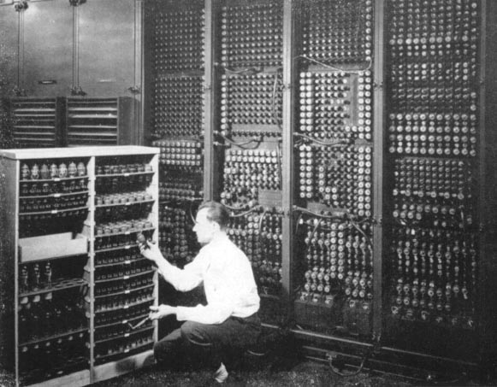

http://www.computermuseum.li/Testpage/05HISTORYCD-ENIAC-Photos-I.htm
"Electronic Numerical Integrator and Computer"
The ENIAC was over 100 feet long, circling a room 30 feet by 50 feet. It was 10 feet high and about 3 feet deep.
The ENIAC contained over 18,000 vacuum tubes and programs had to be physically wired into the computer. The ENIAC weighed about 30 tons and was used to integrate ballistic equations and calculate trajectories of naval shells.
The ENIAC was completed in 1946 and remained in use until 1955. The original cost of the system was about $486,000.
The ENIAC was predated by the Atanasoff Berry Computer and the Colossus (1943) developed at Bletchley Park UK as the very first electronic digital computer
Could hold just 20 10 digit decimal numbers
From Lexikon's History of Computing Encyclopaedia on CD ROM

Slide 17
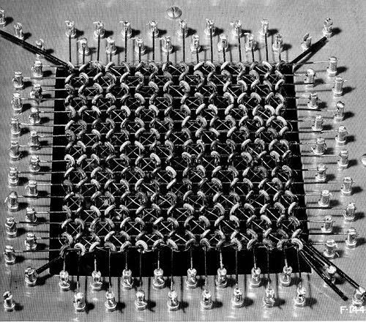
Central Memory? None until 1951
A 1950’s core memory design. Each core shown here is several millimetres in diameter.

Slide 18
Definition
For any algorithmic solution A we define the time complexity function T _{A}(n) as the maximum number of relevant primitive operations that have to be performed by A on a problem of size n.
Example
A class does a test which is marked out of 70.
The marks must be transformed to make them percentages % ( out of 100)
Two algorithms are proposed to do this scaling

Slide 19
Here are the original results and the results after the algorithm is applied
Jane got 70/70 so has 100%
The algorithm to achieve the scaling reads the original marks in from an array X
NOTE the scale factor is stored in X(0)
70 | 56 | 42 | 14 | 56 | 70 | 35 | 42 | 49
X(0) | X(1) | X(2) | X(3) | X(4) | X(5) | X(6) | X(7) | X(8)

Slide 20
Which algorithm is faster?
Here we are assuming that we are reading n values from the array
ScaleMarks
READ X(array)
total←70
FOR i = 1 To n
X(i) ←X(i) * 100/total
NEXT i
DISPLAY X
End ScaleMarks
ScaleMarks
READ X(array)
factor←100/70
FOR i= 1 To n
X(i) ←X(i) * factor
NEXT i
DISPLAY X
End ScaleMarks
A
B
Each time the loop is executed there is a multiplication and a division so T_{A}(n) = 2n
There is one division at the start and then each time the loop is executed there is a multiplication so T _{B}(n) = n+1
/
* /
*
n
n

Slide 21
Does it matter?
T_{A}(n) = 2n, T _{B}(n) = n+1
The difference is going to depend on the size of n
If n = 5 we have
10 operations for A and 6 for B
If n = 10 we have
20 operations for A and 11 for B
If n = 100 we have
200 operations for A and 101 for B
If n = 1000 we have
2000 operations for A and 1001 for B

Slide 22
Another example (in handbook)
Consider 2 algorithms for finding the sum of the rows of a matrix and then the sum of all elements in the matrix.
First each row is summed and the totals for each row, sum(i), are displayed Then the final total, Grandsum, of all the elements is calculated and displayed
The general element of the matrix A is written here as a(i,j) so for example the element on the second row in the third column is called a(2,3).
⎛
1
5
2
=
8
⎜
⎜
4
0
3
=
7
⎜
=
2
8
1
11
⎜
⎜
=
⎝
5
3
2
10
36

Slide 23
MatrixSum
READ a(array)
Grandsum ←0
FOR i = 1 TO 4
Sum(i)←0
FOR j = 1 TO 3
Sum(i)←Sum(i) + a(i,j)
Grandsum ← Grandsum + a(ij)
DISPLAY Sum(i)
NEXT j
NEXT i
DISPLAY Grandsum
End Matrixsum
MatrixSum
READ a(array)
Grandsum ←0
FOR i = 1 TO 4
Sum(i)←0
FOR j = 1 TO 3
Sum(i)←Sum(i) + a(i,j)
DISPLAY Sum(i)
NEXT j
Grandsum ← Grandsum+Sum(i)
NEXT i
DISPLAY Grandsum
End Matrixsum
A
B
In these algorithms the inner loop will add the row elements up so j will go from 1 to 3.
The outer loop will total these row sums and so i will go from 1 to 4

Slide 24
Time complexity
Both algorithms work by using a double loop but the two algorithms get the total (Grandsum) by putting similar statements in different places in the algorithm
When we analyse the time complexity of these algorithms we look to see how often a critical operation (addition in this case) takes place.
In A we have both Sum and Grandsum calculated 12 (4×3) times so have 2(12) = 24 operations
In B we have Sum calculated 12 times but Grandsum only 4 times so have a total of 16 operations.

Slide 25
The difference in computer time in these cases will be negligible but consider the general case where both i and j have been replaced by n allowing us to use this algorithm with any size matrix. We rename A and B with versions C and D
Now we have algorithm T_{C}(n) = 2n² and T_{D}(n) = n²+n.
For all values of n , 2n² > n²+n so we can say D is apparently guaranteed to execute faster than C.
If we take the case where n is 1000 and a computer only capable of processing one instruction each microsecond the comparison between C and D will be about 2 second to 1 second so not noticeably different. On a 100 000 by 100 000 matrix the difference is significant with 6 hrs as opposed to 3 hours. (ref Thomas L Naps)

Slide 26
Travelling Salesman
All connections possible
Travel to each one only once
Return to start
Find shortest route
A
B
This path will be ABCDA which we will call DIST(1)
D
C

Slide 27
Find the shortest starting at A
length ABCDA = DIST(1)
length ABDCA= DIST(2)
length ACBDA= DIST(3)
length ACDBA= DIST(4)
length ADCBA= DIST(5)
length ADBCA= DIST(6)
Shortest Route
Calc DIST (1)
MinDist←DIST(1)
FOR i = 2 to 6
Calc DIST(i)
Dist(i)
IF Dist(i)<MinDist THEN
MinDist←Dist(i)
NEXT i
End Shortest Route
6 routes from A to A
A * * * A
A 3 2 1 A choices
Each one has 4 distances to add up
Total operations 4x3x2x1 = 4!
In general with n places n!

Slide 28
A
11
B
DIST(1) = 11+8+4+10 = 33
DIST(2) = 11+6+4+13 = 34
13
6
10
8
D
4
C
A
B
A
B
11
11
13
6
10
8
4
D
C
D
C
4

Slide 29
The dreaded factorial !
n! has a nasty habit of growing very large
4! = 4x3x2x1 = 24
5! = 5x4x3x2x1 =5x(4x3x2x1) = 5x4! = 120
6! = 6x5! = 720
7! = 7x6! = 5040
8! = 8x7! = 40 320
9! = 9x8! = 362 880
10! = 10 x 9! = 3 628 800 over 3 million

Slide 30
Running out of time
In general the time Complexity function T for this problem with a graph with n vertices
all connected to each other ( the so called complete graph) T _{A} (n) can be seen to be n!
This is a problem as can be seen from the table updated from (Fenton 1993)
Execution times for different algorithms assuming 1 execution per nanosecond [Fenton 1993 updated]
 | Time Complexity T(n) of algorithm in ascending order
Size of input | log₂n | n | n² | 2^{n} | n! | n^{n}
10 | 0.000000 003 Seconds | 0.000 000 01 seconds | 0.000 000 1 seconds | 0.000 001 seconds | 0.0036 seconds | 0.168 minutes
100 | 0.000 000 007 Seconds | 0.000 000 1 seconds | 0.000 01 seconds | 10¹¹ centuries | 10¹⁴³ centuries | 10¹⁸² centuries
1000 | 0.000 000 01 seconds | 0.000 000 1 seconds | 0.001 second | - | - | -
10 000 | 0.000 000 013 seconds | 0.000 01 seconds | 0.1 seconds | - | - | -
100 000 | 0.000 000 017 seconds | 0.000 01 seconds | 0.168 minutes | - | - | -
Those entries left blank exceed the expected life span of the universe!

Slide 31
Orders of magnitude
Error message 1970’s
Using mainframe and remote jobs
Program to add 2 numbers
2 weeks
Error message 2000’s
Using lab PC
Program to add 2 numbers
Less than 2 seconds

Slide 32
We could order these houses by size, price, location even but they would clearly be in 4 different classes
Within these discrete sets
of the same order there is
scope for much variation.

Slide 33
Big O notation
We divide up the classes of algorithms by counting primitive operations
We look at the dominant term to give it its big O classification
E.g. if T _{A} (n) = n² + n then it has O(n²) because as n increases T will grow at the same rate as n²
As we can see from the table the only algorithms that will execute in reasonable time for large n are O(n^{k}) i.e. they have polynomial complexity

Slide 34
Polynomial complexity
T(n) = 7n+1
T(n) = 2n + 6
T(n) = n²+1
T(n) = 3n²+5n+4
T(n) = n(2n +1)
O(n)
O(n⁴)
O(n²)
T(n) = n⁴+2n-1
T(n) = (n²+5)²
T(n) = n⁴ +3n³+2n

Slide 35
BubbleSort
READ a(array)
FOR i = 1 TO n-1
FOR j = 1 TO n-i
IF a(j)>a(j+1)THEN
SWAP (a(j),(j+1))
NEXT j
NEXT i
DISPLAY a
End BubbleSort
3
2
4
6
5
1
1
2
3
4
5
6
Worst case when a list of 9 is exactly the wrong way round gives 8+7+6+5+4+3+2+1 ‘comparisons and swaps’ = 36
In general the formula for an array of n numbers gives
(n-1) +(n-2) + (n-3) + …..+1 comparisons =
So Bubble Sort has for worst case O(n ²)
(Merge Sort has O(n logn))
a(1)
a(2)
a(3)
a(4)
a(5)
a(6)
a(7)
a(8)
a(9)
i=1
i=2
i=3

Slide 36
Turing Machine and computability
Definition
A Turing Machine M = {S, I, f, s ₀ } consists of S a finite set of states, an alphabet I containing the blank symbol B and a partial function, f , from S×I to S×I×{R,L}
So a typical function would be f(s₁, A) = (s_{2,} ,C, R)
s₁
s₂
s₀
s₁
s₂
s₀
S
S
f
R
L
B
A
C
B
A
C
I
I

Slide 37
This rather frightening definition can be interpreted in terms of a control head that can read and write symbols on an infinite tape and move left or right and halt if the partial function is not defined.
Each of the moves of f are considered as quintuples giving the domain and codomain values i.e.
f(s₁, 1) = (s_{2,} ,0, R) is rewritten (s₁, 1, s_{2,} ,0, R)
This can be illustrated as read, write, change, move
B | 0 | 1 | B | 1 | 1 | 0 | 0 | 1 | B | B
0
s₀
s₀
s₁
s₄
s₁
s₄
s₂
s₃
s₂
s₃
If there is no quintuple starting (s_{2,} 1,… ) we must HALT

Slide 38
Church-Turing thesis
For any problem that can be solved by an effective algorithm there is an equivalent Turing machine that can solve this problem
So IF an algorithm is said to be computable it is equivalent to saying we can construct a Turing Machine to carry out the same procedures.

Slide 39
A further example
Here S = {s_{0,}s₁ s₂ s₃ s₄} and I = {B,0,1}
Find the final position, state and tape given the starting position below ( s ₀ at the first non blank position on left) and the possible moves ( instruction set)
(s ₁, 0,s₂, 1, R), (s₂, 1,s₁, 0, L), (s₀, 1,s₂, 0, R), (s₂, 0,s₃, 0, R),
B | 1 | 1 | 0 | 0 | B | 0 | 0 | 1 | B | B
0
1
0
s₀
s₀
s₀
s₀
s₀
s₁
s₁
s₁
s₁
s₄
s₁
s₄
s₄
s₄
s₄
s₂
s₂
s₂
s₂
s₃
s₂
s₃
s₃
s₃
s₃

Slide 40
The Halting Problem
The Halting Problem is a well known example of a non-computable problem. Suppose there was a standard program called Halt that takes as input any Program, P, and tells us whether P terminates. So Halt(P) is either Yes or No.
HALT
Program P
Yes/No

Slide 42
Tutorial & searching algorithms explained
Linear Search
Binary Search
Note all 3 comparison = 1 operation (each loop)
3 weeks lectures + 1 week revision left
Next week Calculus then Complex numbers & Probability – DON’T MISS OUT}

Slide 43
list of items in order
LinearSearch READ Array(X), w i←0 Found =false Failure = false DO IF w = X(i) THEN DISPLAY i Found = true ELSE IF w<X(i) THEN Failure = true ELSE i←i+1 ENDIF IF i>n-1 THEN Failure = true ENDIF LOOP UNTIL Found = true OR Failure = true End LinearSearch
input list and item
X =
at | cod | give | jam | kite | lock | pea
set initial values
item to look for
w = pea
pea=X(0)?
pea=X(1)?
pea=X(2)?
pea=X(3)?
pea=X(4)?
pea=X(5)?
pea=X(6)?
Length = 7
7 comparisons
if you find it at given position
set flag true
if its before next in list its not there
carry on to the next
conditions to stop
gone off the end

Slide 44
BinSearch READ Array(X), w F←0 L←n-1 Found =false Failure = false DO i←⎣(F+L)/2⎦ IF w = X(i) THEN DISPLAY i Found = true ELSE IF w<X(i) THEN L←i-1 ELSE F←i+1 ENDIF IF F>L THEN Failure = true ENDIF LOOP UNTIL Found = true OR Failure = true End BinSearch
input list and item
list of items in order
X =
at | cod | give | jam | kite | lock | pea
set initial values
item to look for
w = pea
find halfway
set flag true
F = 0 L = 6
pea=X(3)?
F = 4 L = 6
pea=X(5)?
F= 6 l = 6
pea=X(6)?
Length = 7
3 comparisons
if you find it give the position
Note ⎣ x ⎦ is the so called floor function
⎣ x ⎦ is the largest integer not greater than x i.e. the next whole number down.
⎣ 2.5 ⎦ = 2
move the ends depending which side of the middle you want
if the top overlaps the bottom failed

Slide 45
For interest- Kruskal’s Algorithm implemented in Java
With acknowledgement to
Krishna Kumar
http://www.krishami.com/programs/java/kruskal.aspx

Slide 46
D
6
1
E
A
5
7
4
2
C
F
3
B

Slide 47
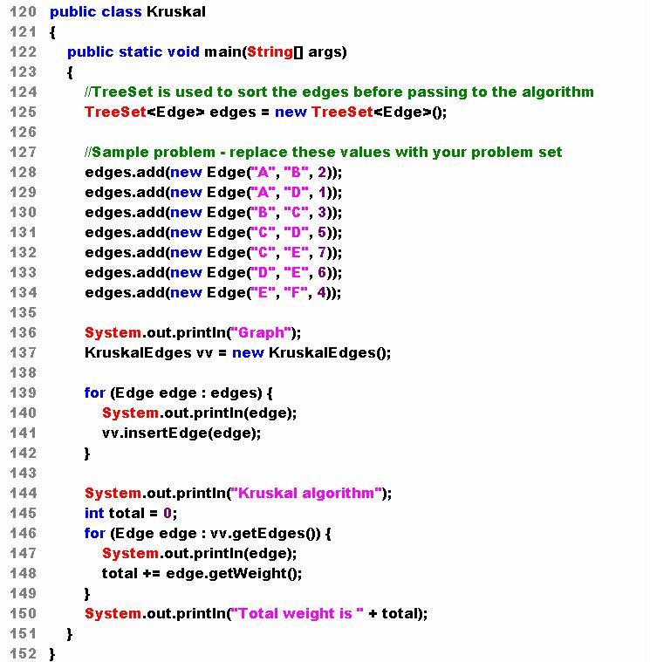
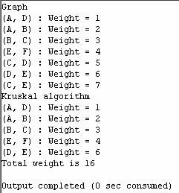
D
6
1
E
A
5
7
4
2
C
F
B
3

Slide 48
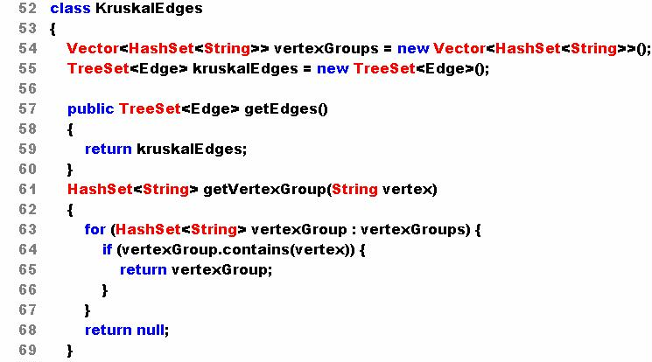

Slide 49
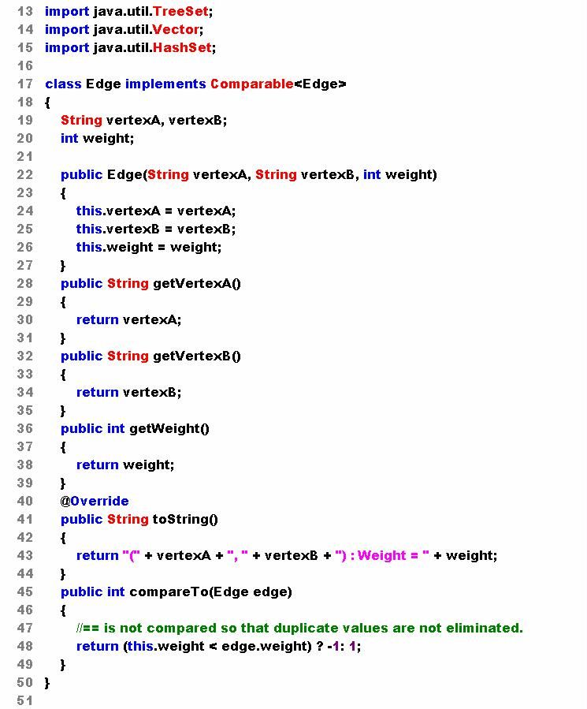

Slide 50
